Slide 1



Machine Learning approach to study the spontaneous combustion characteristic of coal
Under the mentorship of
Prof. Patitapaban Sahu
Presented by:
Charmila Gollavilli - 20JE0287
Md. Athar Imam - 20JE0555
Priyanshu Singh - 20JE0732

Slide 2

Introduction
Spontaneous combustion is a very common occurrence in coal mines and is a major factor contributing to the mine fire
Spontaneous combustion may be defined as the self heating of coal or other carbonaceous material resulting eventually in its ignition without the application of external ignition source due to auto-oxidation.
There are numerous cases of mine fire due to spontaneous combustion of coal all over the world. Like Jharia mine fire(since 1916) in India ,Centralia mine fire in Pennsylvania, USA( 1962) etc.
Mine fires give rise to environmental problems, safety hazards and economic losses

Slide 3
Objectives of Project
To assess the spontaneous combustion susceptibility of coal using Machine learning approach and correlate its intrinsic properties with susceptibility indices.
The Important factor which we will consider are
Moisture content
Volatile matter content
Rank of coal
Petrographic content
Ash content
fixed carbon
Crossing point temperature etc. to train the Machine learning model for the prediction of the susceptibility of coal to spontaneous heating.

Slide 4

Scope of work
Proximate analysis of of coal sample to calculate moisture content, Volatile matter, fixed carbon.
Measure of Crossing point Temperature (CPT) of collected samples.
Measurement of wet Oxidation Potential (WOP).
Reviewing existing literature and Works for better selection of ML model parameters.

Slide 5

Literature review
Research paper | Author | Experimetal Method | Remark
Relations between Coal Properties and Spontaneous Combustion Parameters. Turkish Journal of Engineering | Erdogan KAYMAKCI and Vedat D_ IDAR_ I (2000) | Temperature differential method Proximate analysis | Linear regression identifies ash, volatile matter, carbon, hydrogen, exinite, inertinite, and mineral matter as key factors
“Spontaneous combustibility characterisation of the Chirimiri coals, Koriya District, Chhattisgarh, India”, International Journal of Geosciences | Pattanaik et al. (2011) | proximate analysis and differential thermal analysis | higher ranked coals were less prone to spontaneous combustion . degree of proneness to spontaneous combustion increases with the increase of vitrinite and exinite, but decreases with the increase of inertinite content
An Investigation into Spontaneous Heating Characteristics of Coal and its Correlation with Intrinsic Properties | Choi et al. (2013) | CPT (Crossing Point Temperature) and gas chromatography | lower rank can react with oxygen at low temperatures making them more susceptible to spontaneous combustion

Slide 6

Literature review
Research paper | Author | Experimetal Method | Remark
Study on the Spontaneous Combustion Tendency of Coal Based on Grey Relational and Multiple Regression Analysis | Jun Deng et al.(2021) | Grey relation analysis | To better predict the spontaneous combustion tendency, the average pore diameter, hydroxyl, methyl, methylene, and benzene substituent with a high grey relational grade were selected

Slide 7
Spontaneous Combustion Theories
1. Bacteria theory
The bacteria present in coal can also contribute to the heat produced during self-heating.
However ,there is no conclusive proof to authenticate the theory.
2. Pyrite theory:
It was earlier thought that the heat released on oxidation of these pyrites is the reason behind spontaneous heating of coal.
2FeS + 7O2 + 16H2O —> 2 H2SO4 + 2 FeSO4.7H2O + 316 Kcal
But later on researchers established it cannot be the main reason behind it as coal containing very less or no pyrites also exhibited spontaneous heating.

Slide 8
Spontaneous Combustion Theories
3. Phenol theory
The theory suggests that within coal, phenolic hydroxyls and polyphenols exhibit quicker rates of oxidation compared to other chemical groups.
4. Coal-oxygen complex theory
According to this theory, adsorption of oxygen takes on the surface of coal forming a less stable coal-oxygen complex at different temperatures with release of heat and oxidation products like CO ,CO2, and water.
Coal + Oxygen → Coal-Oxygen complex → Oxidized coal + CO, CO2 , H2O
As this reaction is exothermic, there is rise in the temperature of coal which further increases the rate of sorption of O2 and production of heat.

Slide 9
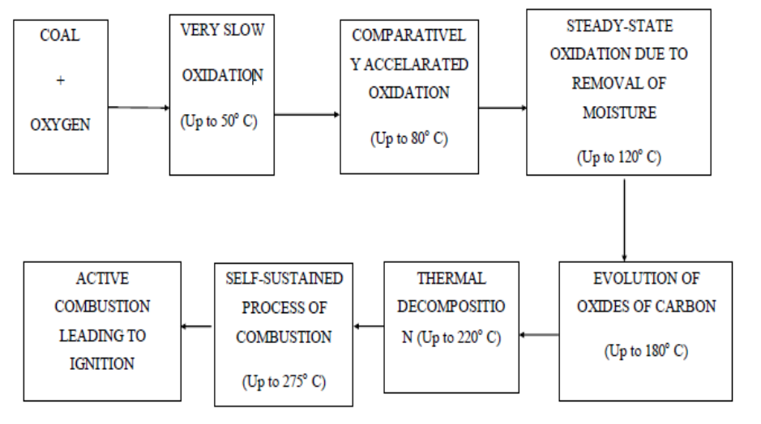
Spontaneous Combustion Mechanism
“An Investigation into Spontaneous Heating Characteristics of Coal and its Correlation with Intrinsic Properties” NITR

Slide 10
Factors affecting spontaneous heating of coal
Intrinsic Factors (Nature of Coal) | Extrinsic factors (Atmospheric ,Geological and Mining condition)
Particle size and surface area Rank of coal petrographic contents Pyrites Moisture Ash content Porosity Volatile Matter | Temperature Coal Seam surrounding strata Seam Thickness Extensive development Ventilation system and Air flow rate Geological disturbance Depth of working etc.

Slide 11

Methodology
Determination of Intrinsic properties of coal
Proximate
Analysis
1
Determination of spontaneous heating susceptibility of coal
Wet Oxidation Potential
1
Crossing Point Temperature
2

Slide 12
Proximate analysis
The test involves heating the coal under various conditions for variable amounts of time to determine i) moisture content ii) volatile matter iii) fixed carbon and vi) ash yield.
i) Moisture content :This is defined as the percentage of moisture in a sample under examination when it is heated just over the boiling point of water (105°C)
% of Moisture = (Loss in weight of coal sample / weight of coal taken) X 100
ii) Volatile matter is defined as the gases driven off when coal is heated to 950°C (1742°F) in the absence of air under specified conditions.
% Volatile matter = (loss in weight at 925°C/ weight of coal taken) X 100
iii) Ash is the inorganic residue that remains after combustion. It is defined as the residue left after the same coal sample is heated at 750°C for half an hour .
% Ash = (weight of residual left in crucible /weight of coal taken)X100
iv) Fixed carbon is the carbon found in the material which is left after volatile materials are driven off
% of Fixed Carbon = 100- (% of Total Moisture + % of Volatile Matter + % of Ash content)

Slide 13
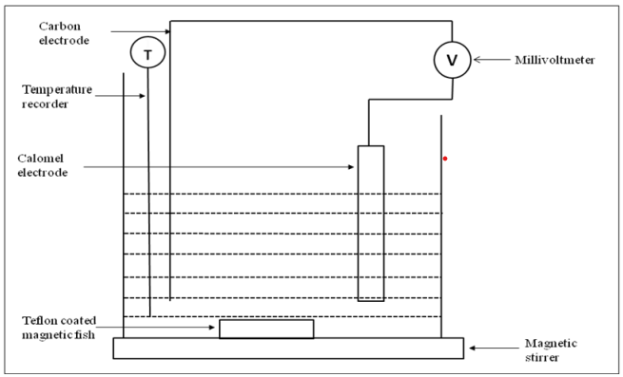
Wet Oxidation Potential (WOP)
In the wet oxidation potential method emphasis is given to change in potential difference during the oxidation process. It has been investigated that 0.2N KMnO4 as a oxidizer in 1N KOH solution is the optimum mixture to carry out wet oxidation potential method for obtaining best response to spontaneous heating of coal.
Equivalence factor of KMnO4 in this case is maintained as 158.04/3 = 52.68.
Principle of WOP: The reduction of permanganate ion to magnate ion is represented as follows:
MnO4- + e- --> [MnO4]2-
The addition of coal leads to the oxidation of the coal sample while the permanganate ion is reduced to magnate ion which results in the change in EMF and the change in potential occurs till the whole oxidation is completely over. The change in potential of the carbon electrode is measured for taking the results. The electrode is represented as carbon/ MnO2- . Different coal samples produce different amount of potential drop and this can be used to compare their relative susceptibilities to spontaneous combustion.
Experimental set up for wet oxidation potential method
Reference: Nat. Sem. RMEII Udaipur,India July 7-9, 2017

Slide 14
Crossing Point Temperature (CPT)
Crossing point temperature (CPT) is the temperature at which the coal temperature coincides with that of the furnace temperature or bath temperature in °C. CPT or critical oxidation temperature gives an idea about the proneness of coal to auto oxidation or self-heating.
In this method oxygen is passed through a bed of coal powder immersed in a glycerine bath, which is heated at a constant rate. Initially the temperature of the bed will be less than that of the bath. Due to coal oxidation being an exothermic reaction, heat will be evolved thereby increasing the temperature of the coal bed, thus reducing the difference between coal and bath temperatures. As temperature of the bath increases, the oxidation rate is enhanced and a stage comes when coal bed temperature equals bath temperature and then exceeds it. The temperature at which both bath and bed temperatures indicate equality is referred to as crossing point temperature and expressed in °C. The higher the crossing point temperature value, the less will be susceptibility of coal to spontaneous heating.
Table : Scale to determine proneness of coal towards spontaneous heating

Slide 15

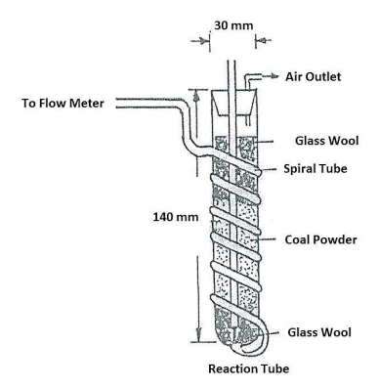
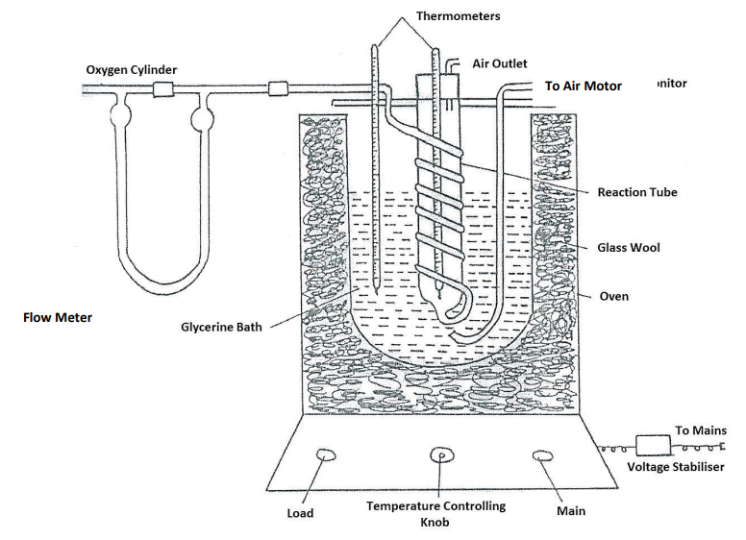
CPT , °C | Spontaneous combustion susceptibility
120-140 | Highly susceptible
140-160 | Moderately susceptible
>160 | Poorly susceptible
Experimental set up for determination of crossing point temperature of coal
Nat. Sem. RMEII Udaipur, India July 7-9, 2017

Slide 16

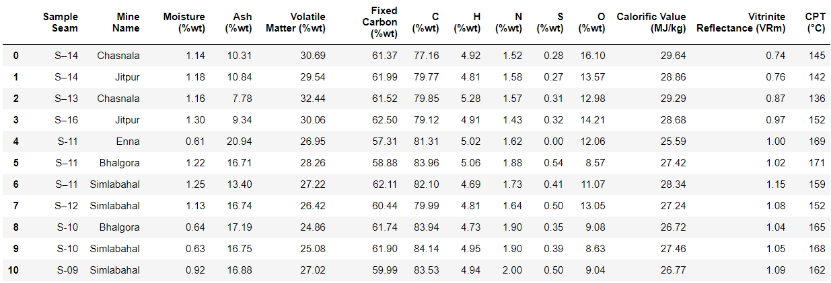
Data
Proximate, ultimate, GCV, and CPT analysis data for the eleven coal samples were extracted from the research paper by N.K. Mohalik, E. Lester, I.S. Lowndes, titled "Development of a modified crossing point temperature (CPTHR) method to assess spontaneous combustion propensity of coal and its chemometric analysis," published in the Journal of Loss Prevention in the Process Industries, Volume 56, 2018, pages 359-369. The paper is available online with the DOI:https://doi.org/10.1016/j.jlp.2018.09.001. The ISSN for the journal is 0950-4230.

Slide 17
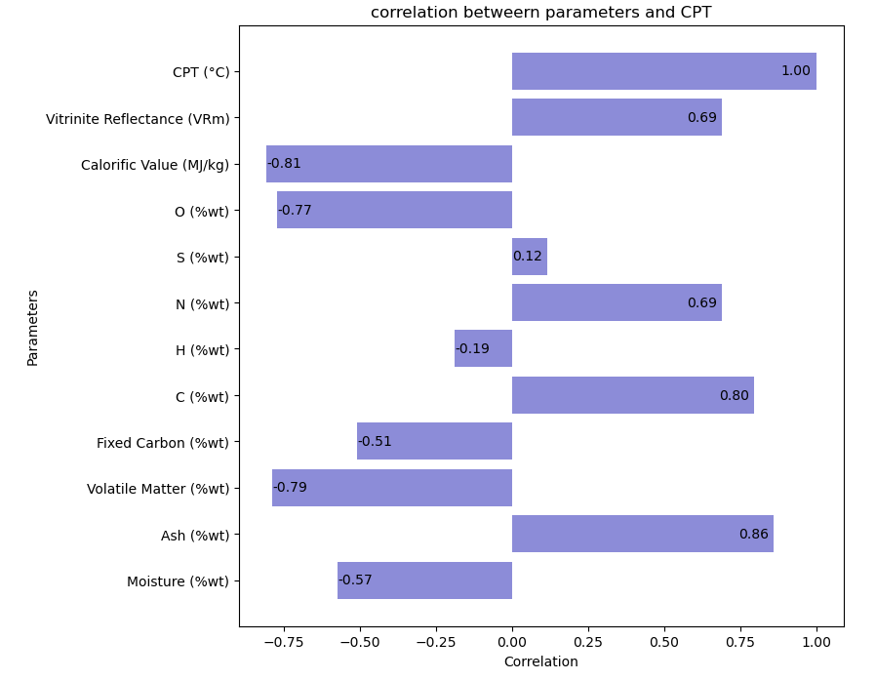
Data Analysis
Moisture: Higher moisture content leads to lower CPT.
Ash: Higher ash content leads to higher CPT.
Volatile Matter: Higher volatile matter leads to lower CPT.
Fixed Carbon: Higher fixed carbon leads to lower CPT.
Carbon: Higher carbon content leads to higher CPT.
Hydrogen: Slight decrease in hydrogen content leads to higher CPT.
Nitrogen: Higher nitrogen content leads to higher CPT.
Sulphur: Slight increase in sulphur content leads to higher CPT.
Oxygen: Higher oxygen content leads to lower CPT.
Calorific Value: Higher calorific value leads to lower CPT.
Vitrinite Reflectance: Higher vitrinite reflectance leads to higher CPT.

Slide 18

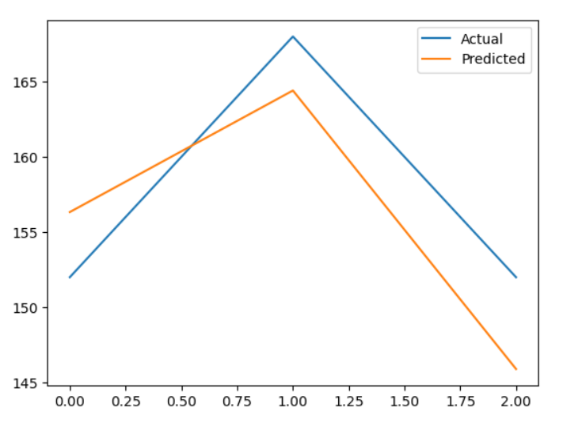
Data Analysis
Index | Actual | Predicted
0 | 152 | 156.33
1 | 168 | 164.41
2 | 152 | 145.90
Root Mean Squared Error : 4.79

Slide 19

Data Analysis
Metric | Training | Test
R-squared | 0.96 | 0.6
Explained Variation | 0.96 | 0.65
MAPE | 1.38 | 3
Mean Squared Error | 6.83 | 22.95
RMSE | 2.61 | 4.79
MAE | 2.15 | 4.67
The linear regression model performs exceptionally well on the training set, as evidenced by high R-squared, low MAPE, MSE, RMSE, and MAE.
However, there is a notable drop in performance on the test set, as indicated by lower R-squared and higher error metrics.
This suggests that the model may be overfitting to the training data, and its performance on unseen data is not as strong. Further evaluation, possibly through increse in dataset size may be needed to improve generalization to new data.

Slide 20
Future Work
Coal Mine Exploration:
Conduct visits to various coal mines for comprehensive exploration.
Collect diverse coal samples representing different geological conditions.
Proximate Analysis and CPT Measurement:
Perform proximate analysis on collected coal samples to determine key properties.
Machine Learning Model Training with Field Data:
Train sophisticated models using authentic data acquired from coal mines.
Ensure the models are well-equipped to handle real-world variations and complexities.
Machine Learning Model Comparison:
Implement various machine learning models to assess and compare their performance.
Evaluate the accuracy of each model in predicting coal-related parameters.

Slide 21
THANK
YOU

